Slide 1
Git Branching
Working with features

Slide 2

What are branches?
A repository has a default branch master
All commits recorded on this branch
Snapshot at each commit point

Slide 3
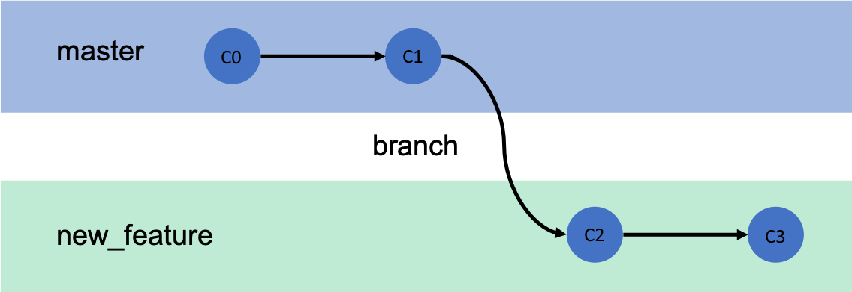
Feature Branches
New branches allow us to work on tasks in a separate workspace
These are called feature branches
Feature branches can be merged back into master

Slide 4



Creating a branch
The git command git branch shows all branches
Create a new branch with git branch <branchname>

Slide 5
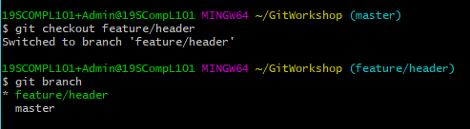
Switch to branch
Git command git checkout <branchname>
Commits made on feature/header are independent

Slide 6
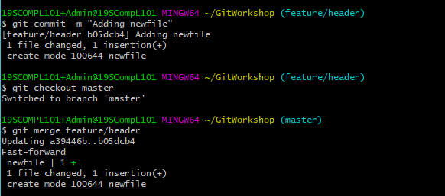
Merging branches
Use command git merge <branchname>

Slide 7
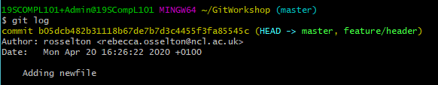

Git log
Use command git log to view changes
Feature/header can be deleted: git branch -d <branchname>

Slide 8
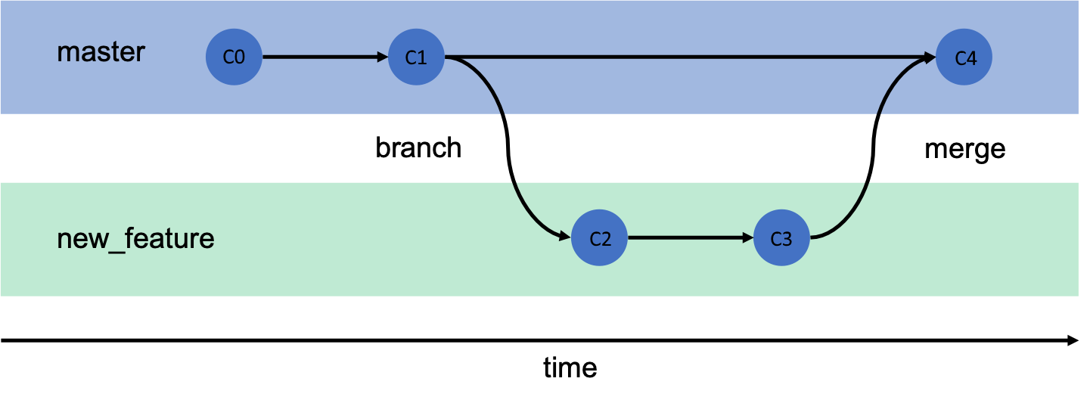
Branches overview

